Slide 1

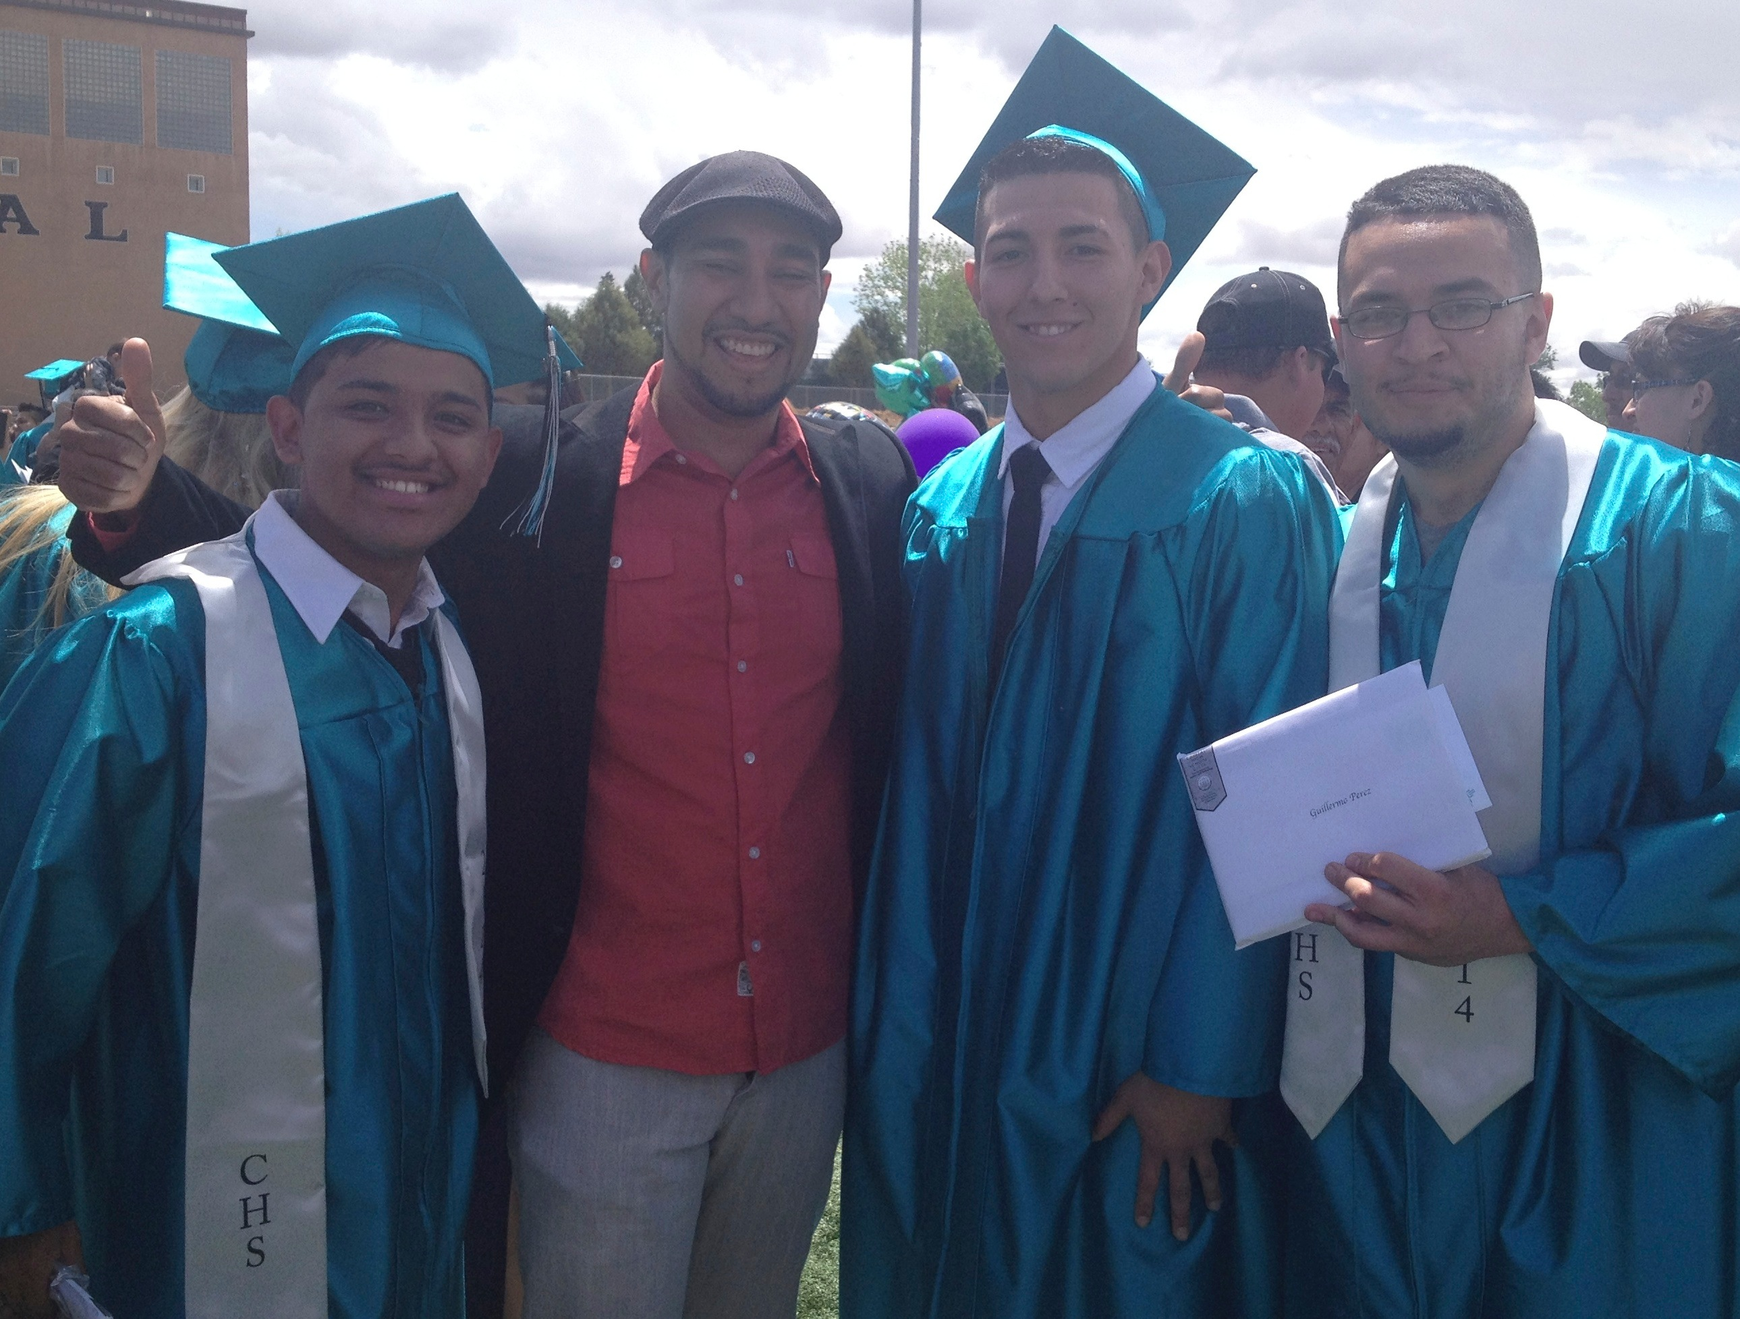
Creating a Supportive Environment for Young Fathers
If we look at males as a culture we can use tried and tested ideas and activities to be culturally competent

Slide 2
How to Involve Men
Recognize and work on your own and your program’s biases
Work to understand men, trust their inherent dedication to their children
Be designing the program to accommodate dads
Acknowledge dads in some way
Give dads jobs to do
Provide safety from ridicule, suspicion and accusation

Slide 3
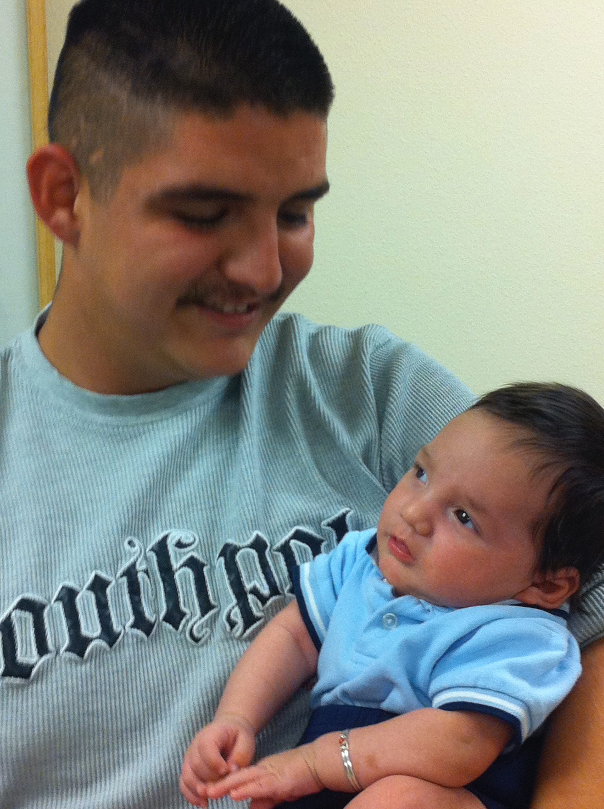
Recognize and work on your own biases
Each staff member should always be doing this
ASK ~ What prevents young men from utilizing your program?
      What art, posters are visible?
      Portrayals and materials
      Is the language inviting? (i.e., “mothers” or “parents”)
Don’t view father as a risk factor, in fact as the opposite

Slide 4
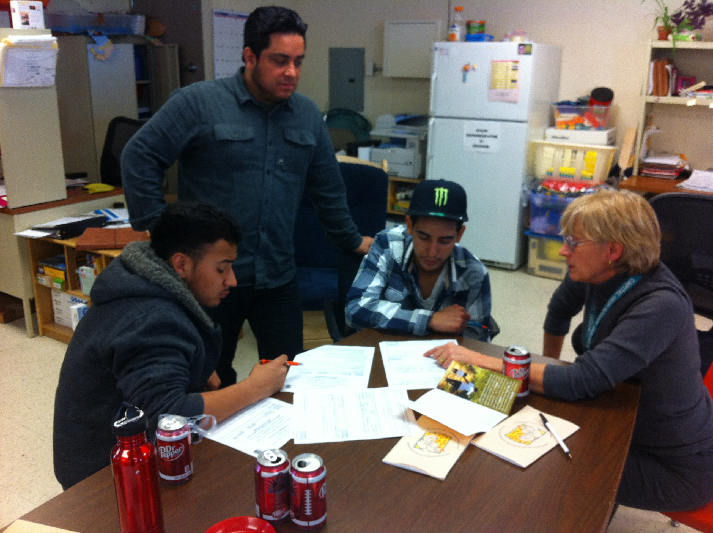
Understanding Men
Men have often been trained and shown how not to express emotion.
The subtle emotions are not identified or named
The one that is allowed to be shown is ANGER
  Men can be overwhelmed trying to be successful in work, relationships, and as parents
  Little opportunity for men to express their pressures (or even aware of it)
  Men are action and solution oriented

Slide 5
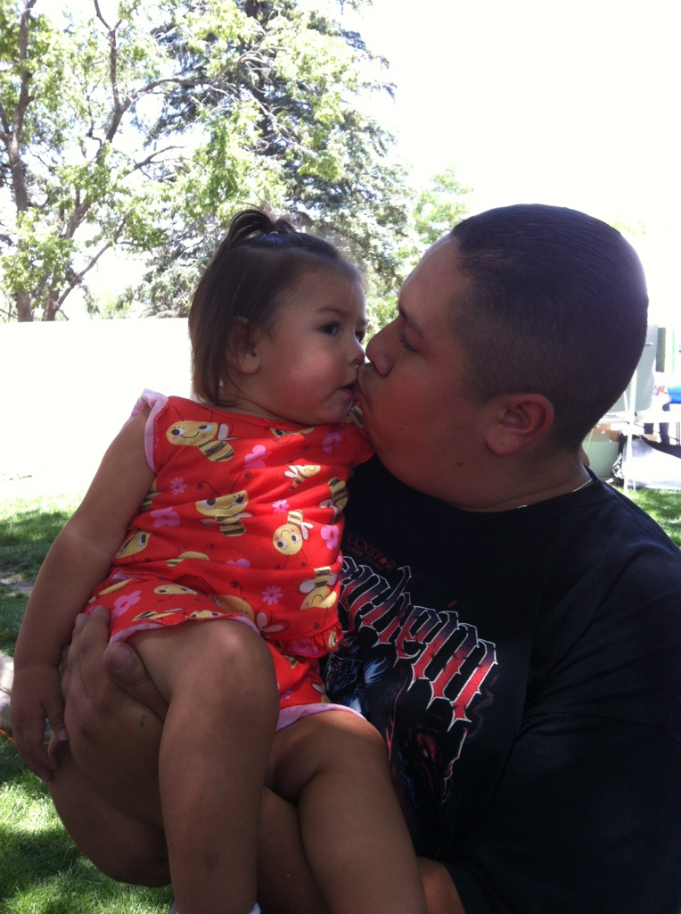
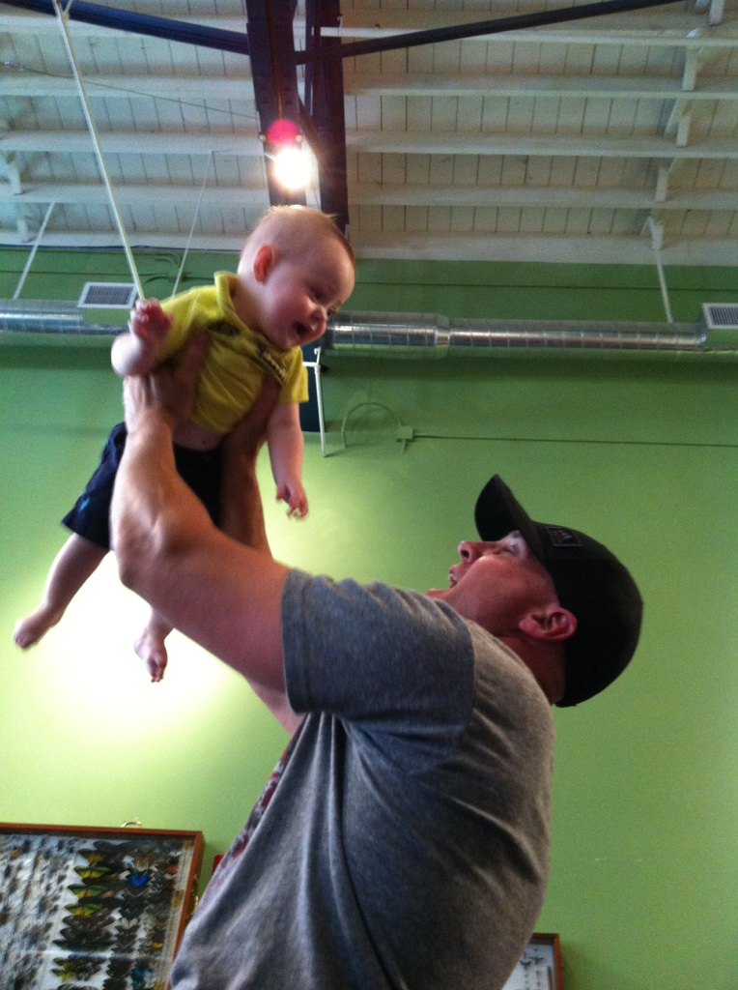
Work to Understand Dads
Dads spend more time in play
Dads will stress physical risk taking
Dads offers less immediate support in face of frustration which promotes better anger management
Dads teach through example, learning from experience
Dads promote exploratory freedom
Dads promote independence outside the home

Slide 6
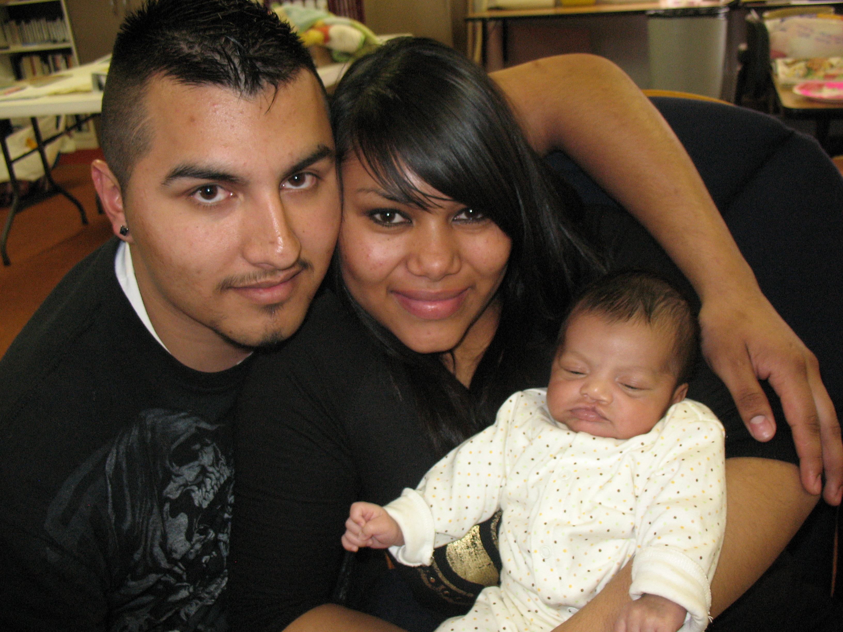
Design for Mothers and Fathers
Help parents to support one another
  Ask mother what father does to support her and to support baby.
  Help her to identify things he does right
  Train on “I messages”
Support mothers encouragement of father involvement
  Awareness of gate-keeping tendency
  Keep all males involved, especially paternal grandfather, as a model for father
  Encourage his providing for and protecting the family

Slide 7
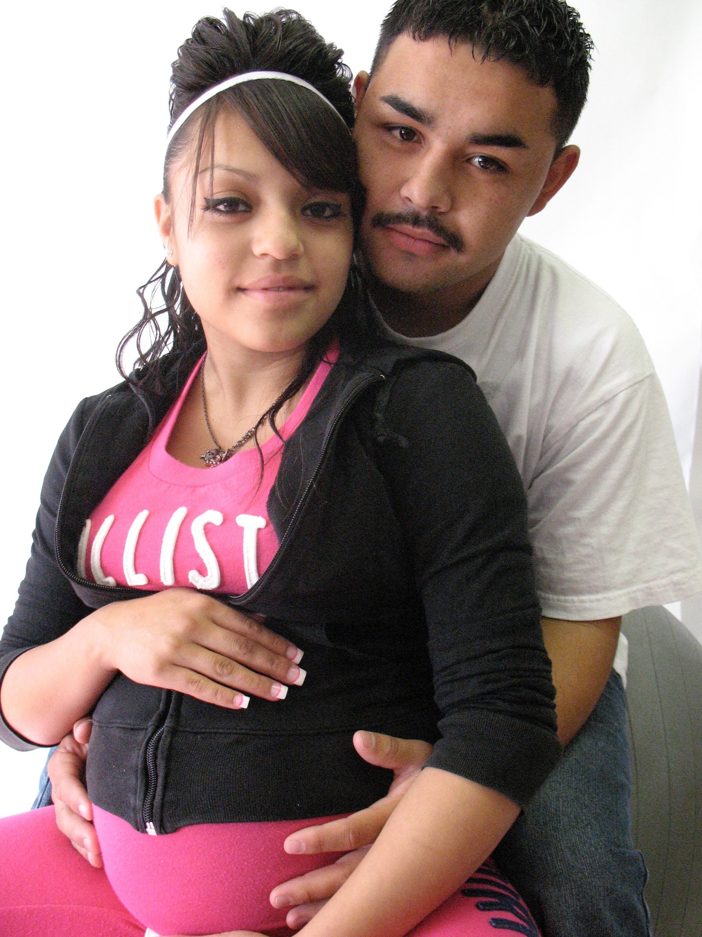
Design for Mothers and Fathers
Create a safe environment for the men to talk openly
Supportive tools for improvement
  Parenting classes
  Mediation
Recognizing the fragility of fatherhood:
Non-residential fathers are at high risk
of no involvement
Purposefully manage conflict

Slide 8
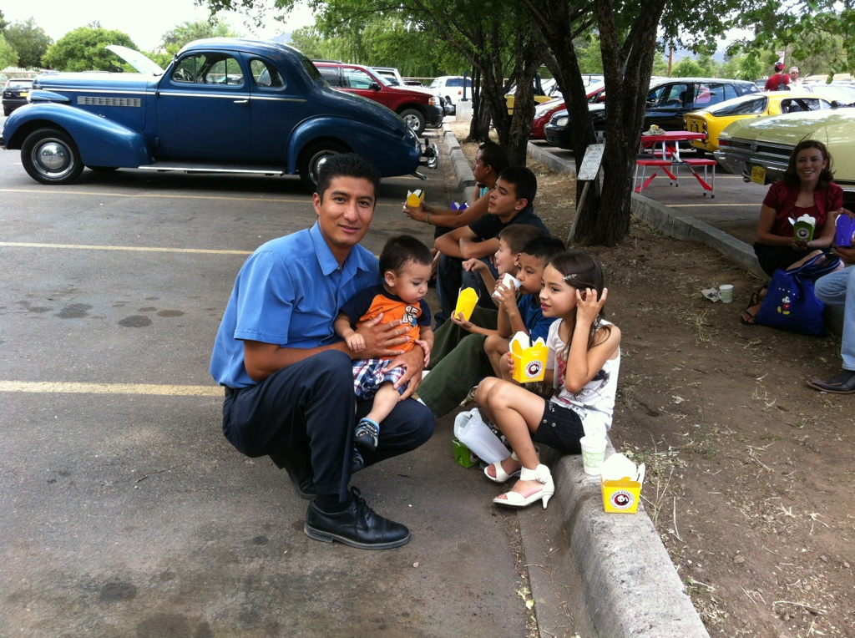
Give Him a Job
  Recognize and Structure his role/contribution
  (because men like to solve problems)
  Give him an action or job to do
  Ask for his ideas and suggested solutions
  Encourage their solutions

Slide 9
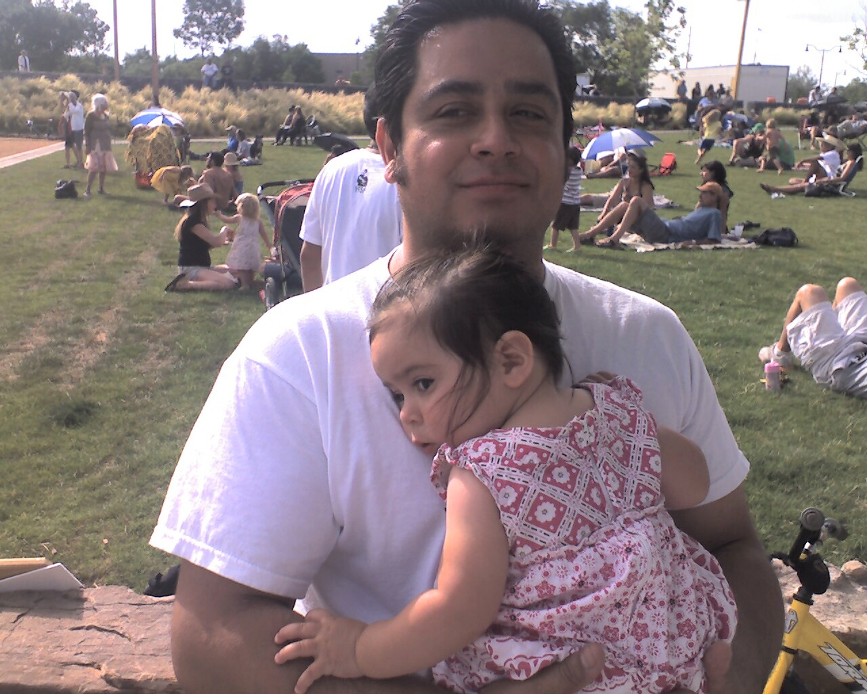
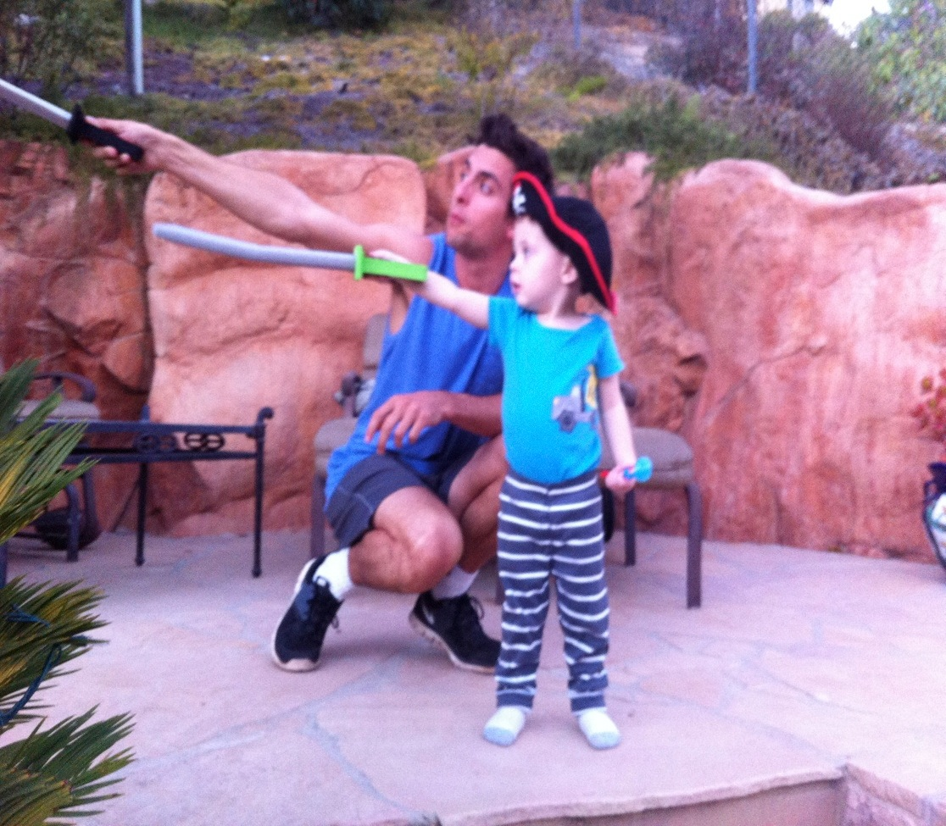
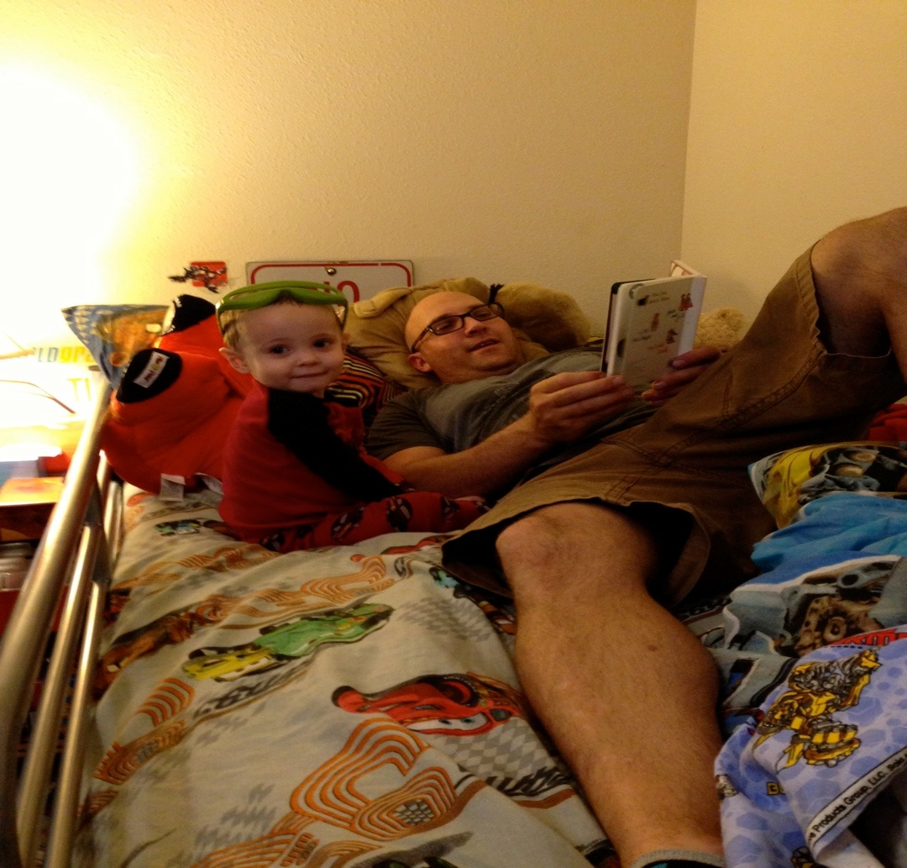
Acknowledgment
Train staff on employing “i messages” - use these to acknowledge fathers (then apply widely!)

Slide 10
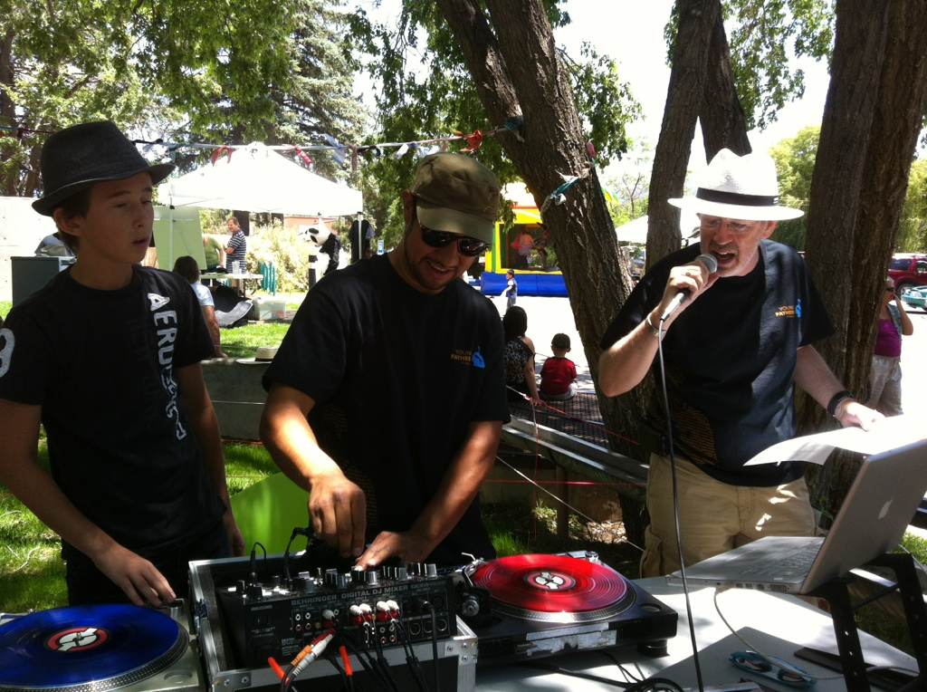
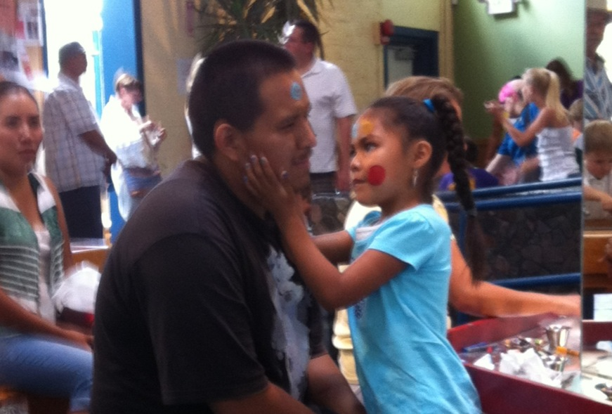
Make It Work!!!
Expect involvement
Plan/Design for it
Change schedule to accommodate
Plan visits so it can happen
Don’t accept anything less

Slide 11
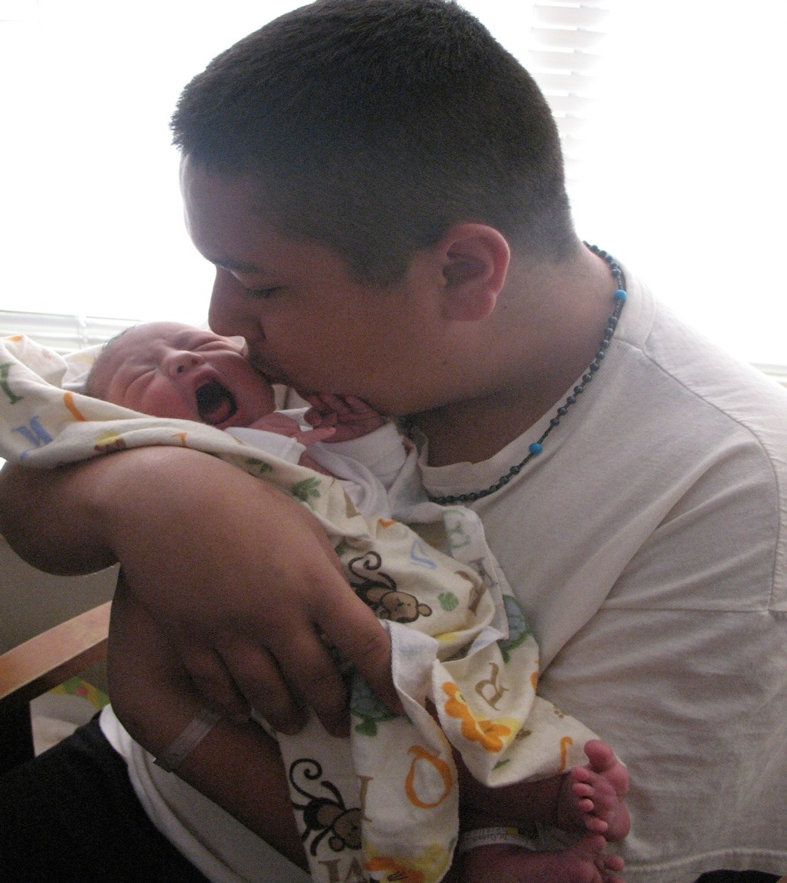
Make It Work!!!
View males as essential, not a risk factor
Invite men in, that may be all they are waiting for
Understand fathers motivation: “provider and protector”

Slide 12
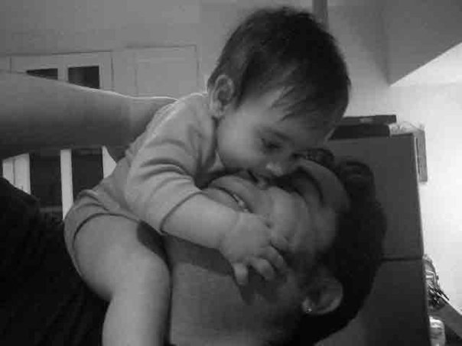
Challenges
With young couples many relationships end during pregnancy.
Guys feel pushed away by mother, mothers family, his family, his friends.
Many guys still have a great need and feel a great responsibility to be involved

Slide 13
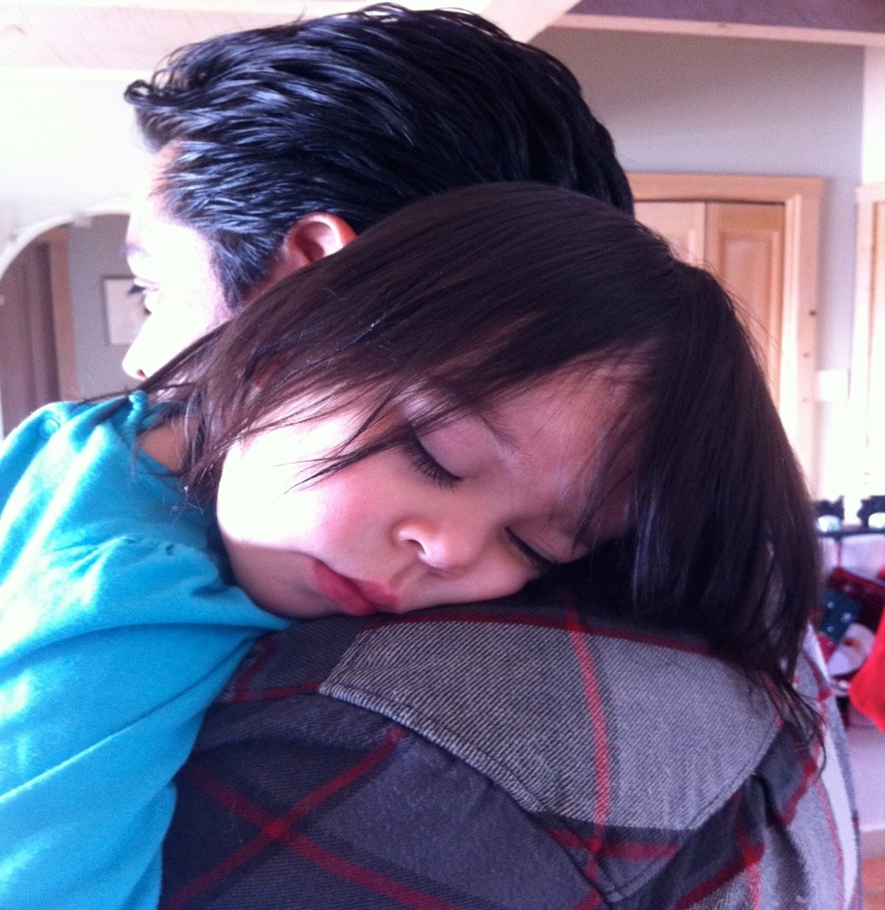
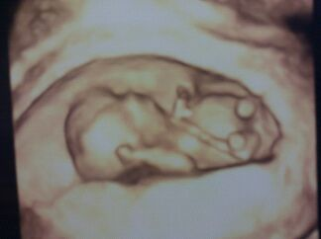
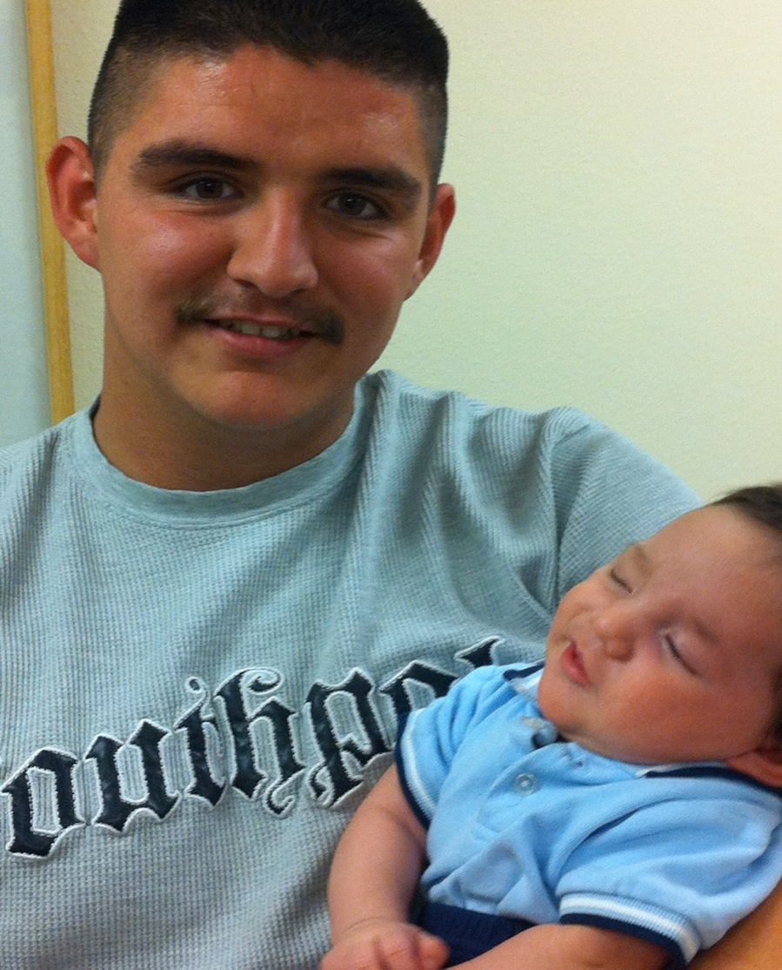
Recognize “Touch Points of Involvement”
Pregnancy
Birth
Illness
Child - starting school/loss of child care
Developmental Milestones (weening, walking, talking, adolescence…)
Father - job loss/going to school

Slide 14
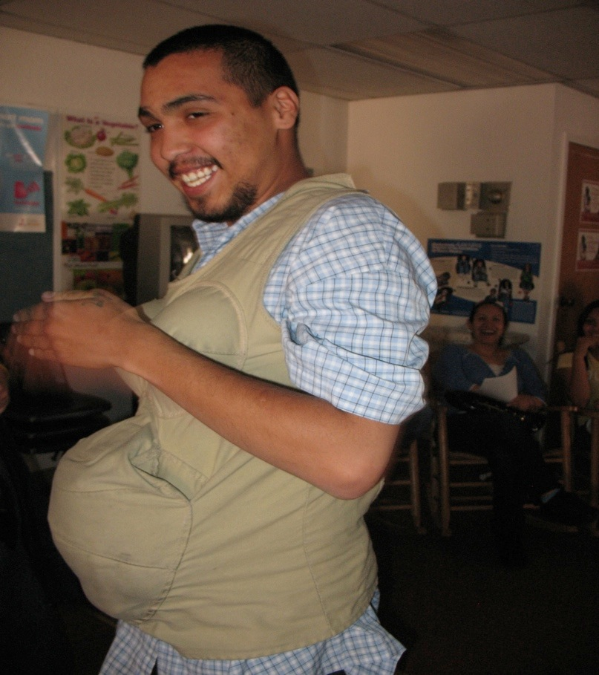

More of what will work
Acknowledge what men do right, not wrong
Give him a task or action he can do
Ask for his ideas and solutions to problems
Create a safe place, free of criticism
Identify his role ASAP
There is not one thing that works, its many

Slide 15
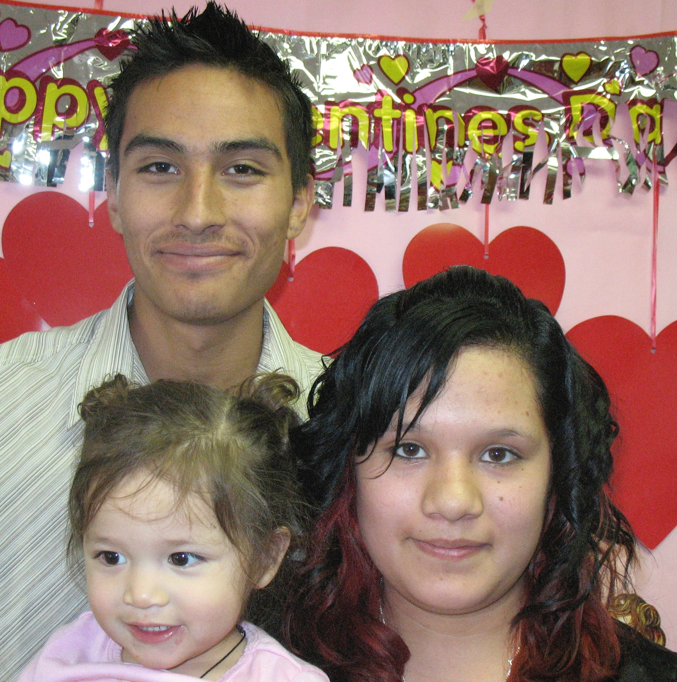
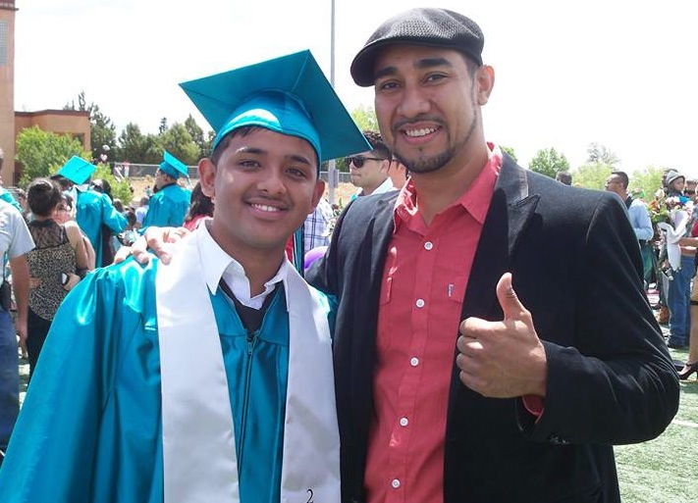
How could you learn more about these cultures
Who are the experts you could consult?
Which colleagues might be resources in helping you learn more about these cultures

Slide 16
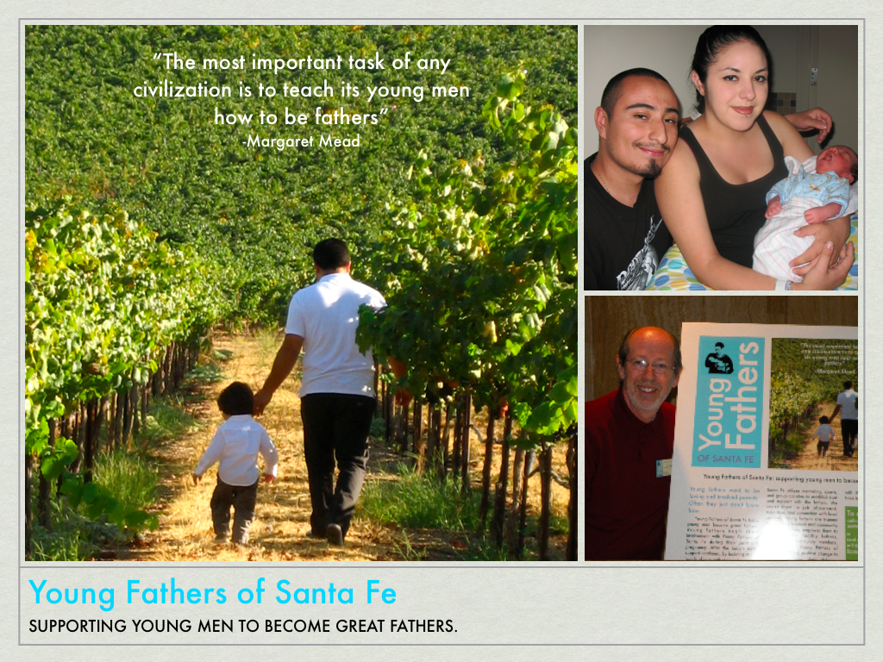
Barry McIntosh, Director
(505) 699-7431
kbmac@cybermesa.com
Johnny Wilson
(505) 377-8950
tokaprod@gmail.com

